Slide 1
Extended Entity-Relationship (EER) Model

Slide 2
EER Model
EER stands for Enhanced ER or Extended ER.
Includes all modeling concepts of basic ER.
Additional concepts:
subclasses/superclasses
specialization/generalization
categories (UNION types)
attribute and relationship inheritance
Constraints on Specialization/Generalization
The additional EER concepts are used to model applications more completely and more accurately.
EER includes some object-oriented concepts, such as inheritance.

Slide 3
Subclass and Superclass
An entity type may have additional meaningful subgroupings of its entities
Example: EMPLOYEE may be further grouped into:
SECRETARY, ENGINEER, TECHNICIAN, …
Based on the EMPLOYEE’s Job
MANAGER
EMPLOYEEs who are managers (the role they play)
SALARIED_EMPLOYEE, HOURLY_EMPLOYEE
Based on the EMPLOYEE’s method of pay
EER diagrams extend ER diagrams to represent these additional subgroupings, called subclasses or subtypes.
Each of these subgroupings is a subset of EMPLOYEE entities.
Each is called a subclass of EMPLOYEE.
EMPLOYEE is the superclass for each of these subclasses.

Slide 4
Subclass and Superclass

Slide 5
Subclass and Superclass
Superclass/subclass relationships:
EMPLOYEE/SECRETARY
EMPLOYEE/TECHNICIAN
EMPLOYEE/MANAGER
These are also called IS-A (or IS-AN) relationships
SECRETARY IS-AN EMPLOYEE, TECHNICIAN IS-AN EMPLOYEE
An entity that is member of a subclass represents the same real-world entity as some member of the superclass.
The subclass member is the same entity in a distinct specific role.
An entity cannot exist in the database only by being a member of a subclass; it must also be a member of the superclass.
A member of the superclass can be optionally included as a member of any number of its subclasses.

Slide 6
Subclass and Superclass
Examples
A salaried employee who is also an engineer belongs to the two subclasses:
ENGINEER, and
SALARIED_EMPLOYEE
A salaried employee who is also an engineering manager belongs to the three subclasses:
MANAGER,
ENGINEER, and
SALARIED_EMPLOYEE
It is not necessary that every entity in a superclass be a member of some subclass

Slide 7
Inheritance
An entity that is member of a subclass inherits
All attributes of the entity as a member of the superclass
All relationships of the entity as a member of the superclass
Example
SECRETARY (as well as TECHNICIAN and ENGINEER) inherit the attributes Name, SSN, …, from EMPLOYEE
Every SECRETARY entity will have values for the inherited attributes.

Slide 8
Specialization
The process of defining set of subclasses within an entity set is called specialization.
The set of subclasses is based upon some distinguishing characteristics of the entities in the superclass.
Example
{SECRETARY, ENGINEER, TECHNICIAN} is a specialization of EMPLOYEE based upon job type.
MANAGER is a specialization of EMPLOYEE based on the role the employee plays.
{SALARIED_EMPLOYEE, HOURLY_EMPLOYEE} is a specialization of EMPLOYEE based on method of pay.
May have several specializations of the same superclass.
Superclass/subclass relationships and specialization can be diagrammatically represented in EER diagrams.

Slide 9
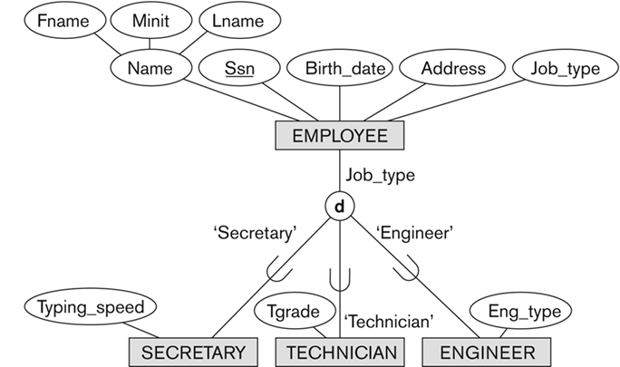
Specialization

Slide 10
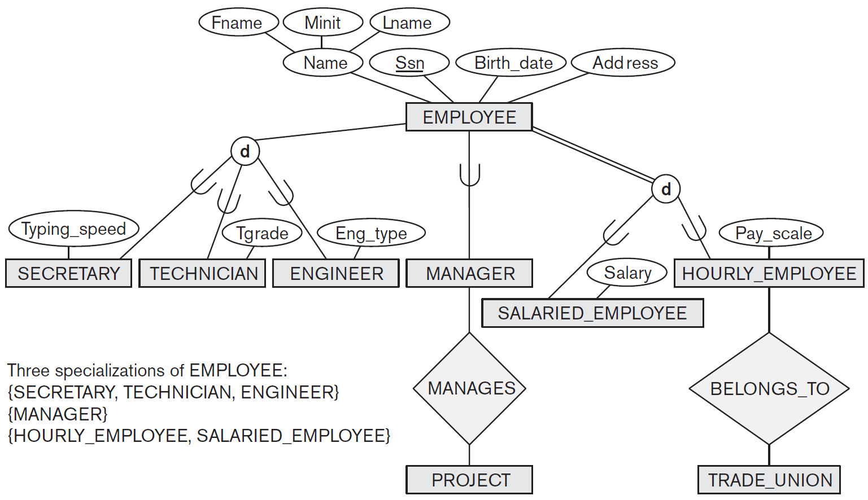
EER diagram notation to represent subclasses and specialization

Slide 11
Specialization
Attributes of a subclass are called specific or local attributes.
For example, the attribute TypingSpeed of SECRETARY
The subclass can also participate in specific relationship types.
For example, a relationship BELONGS_TO of HOURLY_EMPLOYEE
Top-down design process: we designate sub-groupings within an entity set that are distinctive from other entities in the set.
These sub-groupings become lower-level entity sets that have attributes or participate in relationships that do not apply to the higher-level entity set.
Depicted by a triangle component labeled ISA.
A lower-level entity set inherits all the attributes and relationship participation of the higher-level entity set to which it is linked.

Slide 12
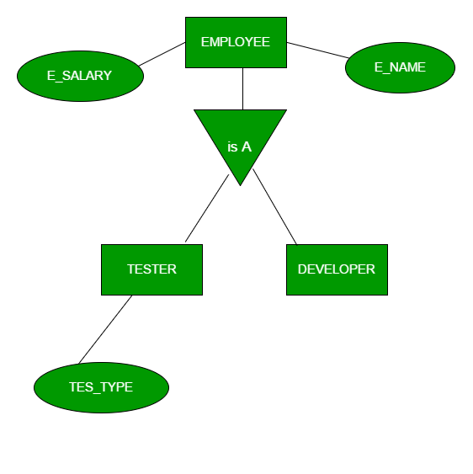
Specialization

Slide 13
Specialization
Overlapping specialization
An entity may belong to multiple specialized entity sets
Disjoint specialization
An entity must belong to at most one specialized entity set.
For an overlapping specialization (as the case for MANAGER and ENGINEER as specializations of EMPLOYEE), two separate arrows are used.
For a disjoint specialization (as the case for SECRETARY and MANAGER as specializations of EMPLOYEE), a single arrow is used.

Slide 14
Specialization

Slide 15
Generalization
Generalization is the reverse of the specialization process.
Several classes with common features are generalized into a superclass.
Original classes become its subclasses
Example: CAR, TRUCK generalized into VEHICLE
Both CAR, TRUCK become subclasses of the superclass VEHICLE.
We can view {CAR, TRUCK} as a specialization of VEHICLE.
Alternatively, we can view VEHICLE as a generalization of CAR and TRUCK.
Generalization refers to the process of defining a generalized entity type from the given entity types.
Generalization is the process of extracting common properties from a set of entities and create a generalized entity from it.

Slide 16
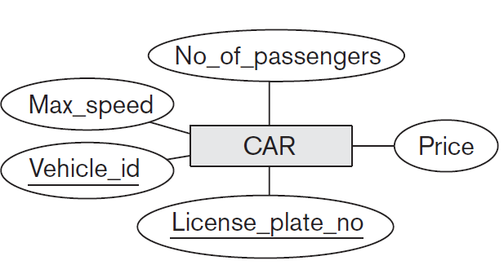
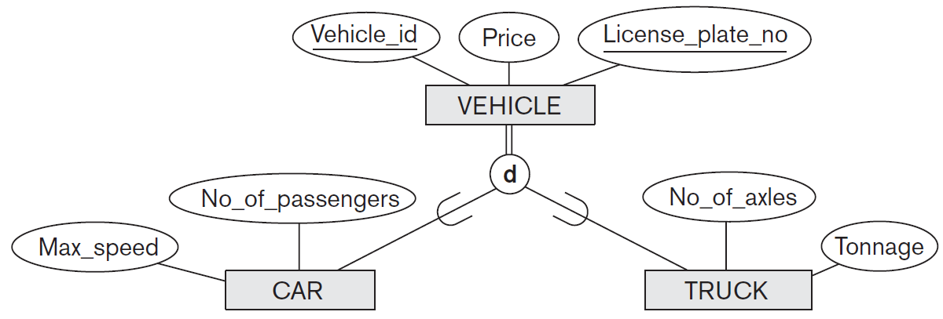
Generalization

Slide 17
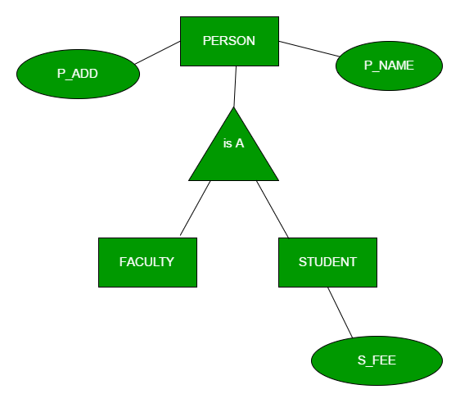
Notations for Generalization and Specialization
Diagrammatic notations are sometimes used to distinguish between generalization and specialization
Arrow pointing to the generalized superclass represents a generalization
Arrows pointing to the specialized subclasses represent a specialization

Slide 18
Generalization
Bottom-up design process – combine a number of entity sets that share the same features (attributes) into a higher-level entity set.
Specialization and generalization are inversions of each other.
Single inheritance - In a hierarchy, a given entity set is involved as a lower-level entity set in only one ISA relationship.
Multiple inheritance - If an entity set is a lower-level entity set in more than one ISA relationship, then the entity set has multiple inheritance.

Slide 19
Constraints
Placing a condition on the value of some attribute: Predicate-defined (job-type), user-defined
Two basic constraints can apply to a specialization/generalization:
Disjointness Constraint
Completeness Constraint
Total
Partial
Disjointness Constraint
Specifies that the subclasses of the specialization must be disjoint
an entity can be a member of at most one of the subclasses of the specialization
Specified by d in EER diagram
If not disjoint, specialization is overlapping
same entity may be a member of more than one subclass of the specialization
Specified by o in EER diagram

Slide 20
Constraints
Completeness Constraint
Total specialization/generalization specifies that every entity in the superclass must be a member of some subclass in the specialization/generalization.
Shown in EER diagrams by a double line to connect the superclass to the circle.
Partial specialization/generalization allows an entity not to belong to any of the subclasses.
Shown in EER diagrams by a single line.
We have four types of specialization/generalization:
Disjoint, total
Disjoint, partial
Overlapping, total
Overlapping, partial
Generalization usually is total because the superclass is derived from the subclasses
Contains only the entities that are in the subclasses

Slide 21
Example of disjoint partial Specialization

Slide 22
Example of overlapping total Specialization

Slide 23
Specialization/Generalization Hierarchies
A subclass may itself have further subclasses specified on it
forms a hierarchy or a lattice
Hierarchy has a constraint that every subclass has only one superclass
Called single inheritance
Basically a tree structure
In a lattice, a subclass can be subclass of more than one superclass
Called multiple inheritance

Slide 24
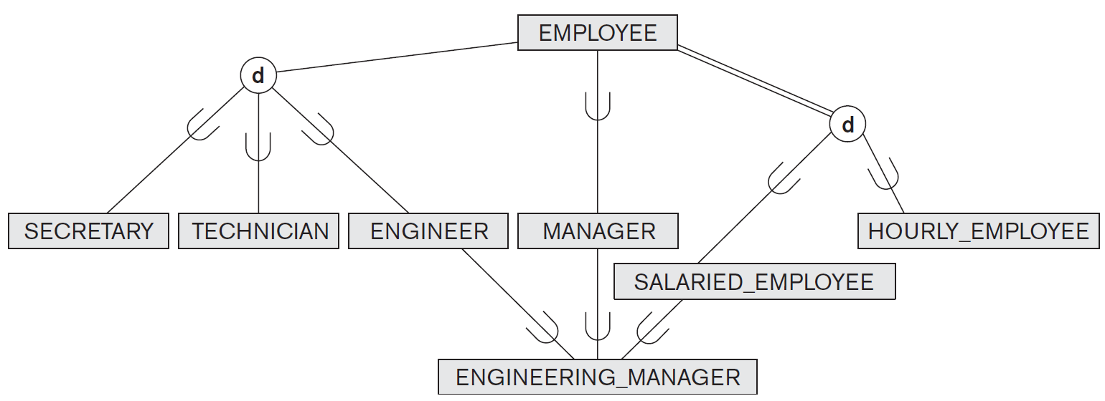
Specialization lattice

Slide 25
Specialization/Generalization Hierarchies and Lattices
In a lattice or hierarchy, a subclass inherits attributes not only of its direct superclass, but also of all its predecessor superclasses.
A subclass with more than one superclass is called a shared subclass (multiple inheritance)
In specialization, start with an entity type and then define subclasses of the entity type by successive specialization
called a top down conceptual refinement process
In generalization, start with many entity types and generalize those that have common properties
Called a bottom up conceptual synthesis process
In practice, a combination of both processes is usually employed

Slide 26
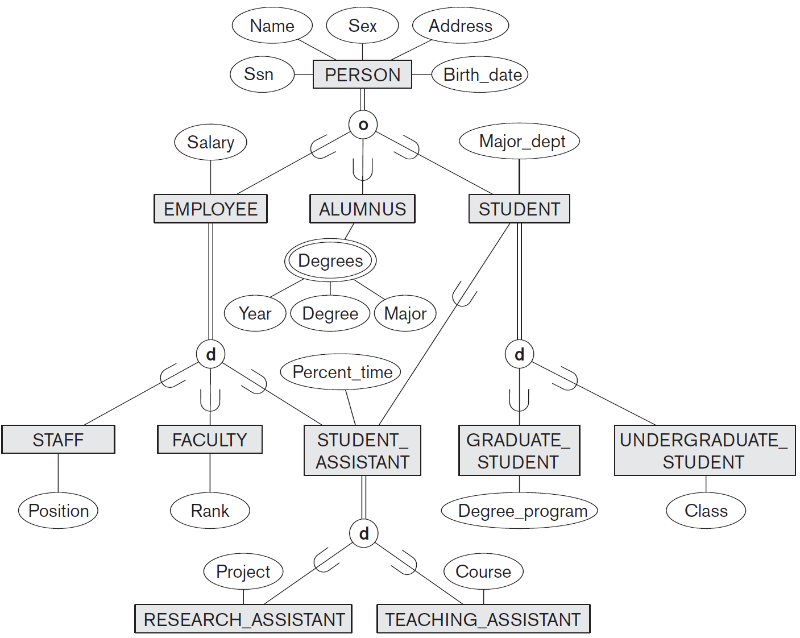
Specialization / Generalization Lattice Example (UNIVERSITY)

Slide 27
Categories (UNION TYPES)
All of the superclass/subclass relationships we have seen thus far have a single superclass.
A shared subclass is a subclass in
more than one distinct superclass/subclass relationships
each relationships has a single superclass
shared subclass leads to multiple inheritance
In some cases, we need to model a single superclass/subclass relationship with more than one superclass.
Superclasses can represent different entity types.
Such a subclass is called a category or UNION TYPE.

Slide 28
Categories (UNION TYPES)
Example
In a database for vehicle registration, a vehicle owner can be a PERSON, a BANK (holding a lien on a vehicle) or a COMPANY.
A category (UNION type) called OWNER is created to represent a subset of the union of the three superclasses COMPANY, BANK, and PERSON.
A category member must exist in at least one of its superclasses.
A category has two or more superclasses that may represent distinct entity types.
Difference from shared subclass, which is a:
subset of the intersection of its superclasses
shared subclass member must exist in all of its superclasses
Category is a subset of the union of its superclasses.
A member of OWNER must exist in only one of the superclasses.

Slide 29
Categories (UNION TYPES)
Category can be total or partial.
Total category holds the union of all entities in its superclasses.
Partial category can hold a subset of the union.

Slide 30
Aggregation
Consider the ternary relationship proj_guide.
Suppose we want to record evaluations of a student by a guide on a project.

Slide 31
Aggregation
Relationship sets eval_for and proj_guide represent overlapping information.
There is redundant information, since every instructor, student, project combination in eval_for must also be in proj_guide.
Every eval_for relationship corresponds to a proj_guide relationship.
Some proj_guide relationships may not correspond to any eval_for relationships.
We can’t discard the proj_guide relationship.
Eliminate this redundancy via aggregation
Treat relationship as an abstract entity
Allows relationships between relationships
Abstraction of relationship into new entity

Slide 32
Aggregation
Aggregation is an abstraction through which relationships are treated as higher-level entities.
We regard relationship set proj guide (relating entity sets instructor, student, and project) as a higher-level entity set proj_guide.
A student is guided by a particular instructor on a particular project.
A student, instructor, project combination may have an associated evaluation

Slide 33
Aggregation
One limitation of the E-R model is that it cannot express relationships among relationships.
An ER diagram is not capable of representing relationship between an entity and a relationship which may be required in some scenarios.
In those cases, a relationship with its corresponding entities is aggregated into a higher level entity.
Aggregation is an abstraction through which we can represent relationships as higher level entity sets.

Slide 34
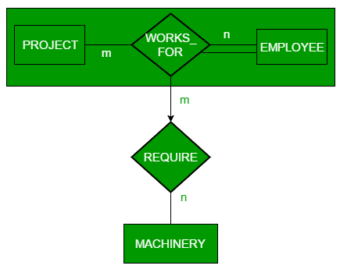
Aggregation
Employee working for a project may require some machinery.
REQUIRE relationship is needed between relationship WORKS_FOR and entity MACHINERY.
Using aggregation, WORKS_FOR relationship with its entities EMPLOYEE and PROJECT is aggregated into single entity.
Relationship REQUIRE is created between aggregated entity and MACHINERY.

Slide 35
Formal Definitions for the EER Model Concepts
A class is a set or collection of entities
could be entity type, subclass, superclass, or category
Subclass S is a class whose:
Type inherits all the attributes and relationship of a class C
Set of entities must always be a subset of the set of entities of the other class C
S ⊆ C
C is called the superclass of S.
A superclass/subclass relationship exists between S and C.
Specialization Z = {S₁, S₂,…, S_{n}} is a set of subclasses with same superclass G.
G is called generalized entity type (or the superclass of the specialization, or generalization of the subclasses {S₁, S₂, ..., S_{n}}).

Slide 36
Formal Definitions for the EER Model Concepts
Z is total if we always have:
S₁ ∪ S₂ ∪ … ∪ S_{n} = G
Otherwise, Z is partial.
Z is disjoint if we always have:
S_{i} ∩ S_{j} = Ø (empty-set) for i ≠ j
Otherwise, Z is overlapping.
Category or UNION type T
A class that is a subset of the union of n different superclasses D₁, D₂,…,D_{n}, n>1
T ⊆ (D₁ ∪ D₂ ∪ … ∪ D_{n})

